Slide 1

WeCare Indoor Positioning Module
Prepared by: Ong Jia Aun
Supervised by: Dr. Zati HAKIM BINTI AZIZUL HASAn
DePartment of Artificial Intelligence

Slide 2

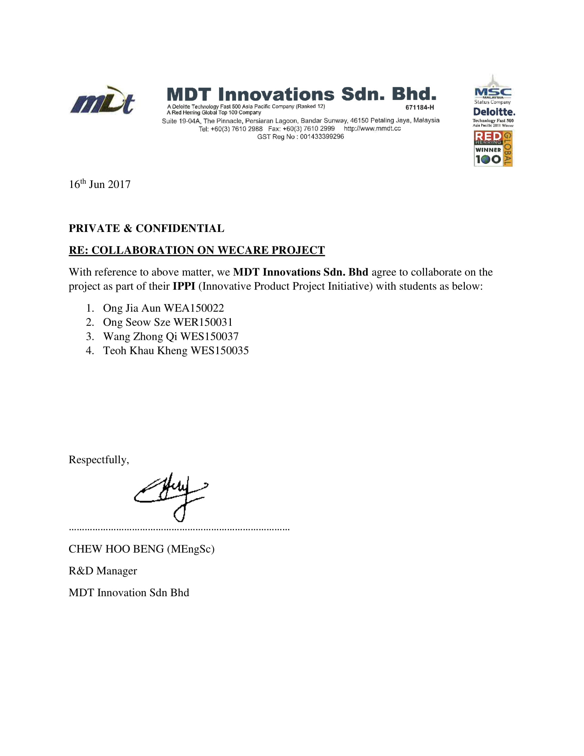
Our Collaborator
Specialises in:
IoT smart devices
RFID technologies

Slide 3
Introduction
According to Census of Fatal Occupational Injuries (CFOI), the construction industry ranked fourth in highest fatal injury rates among all industry.
And yet contractors, especially here in Malaysia, lack of any appropriate approach to comply with the Occupational Safety and Health Administration (OSHA) standard to ensure their workers’ safety in the site.
WeCare provides the solution for an organization to monitor the safety of its members/users by keeping track of their real-time health status and location via wearable. It aims to be a cost-effective and robust system that support multiple language.

Slide 4
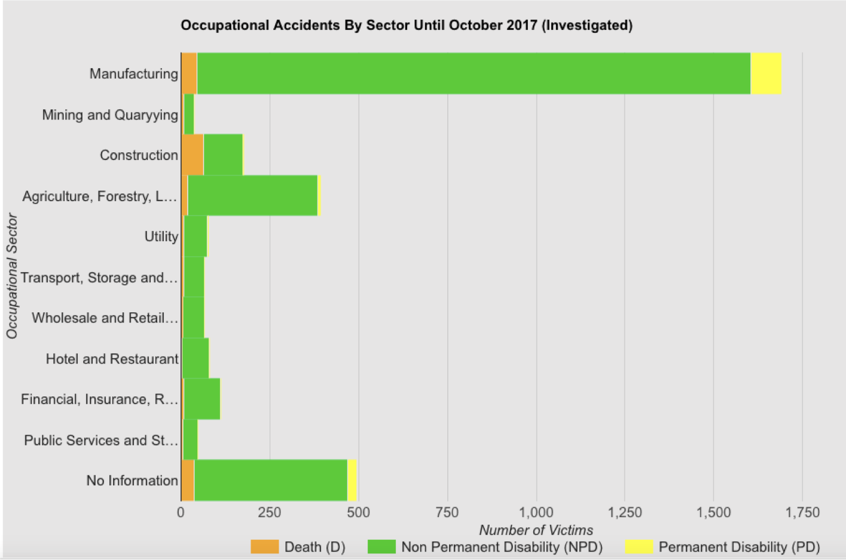
Source: Department of Occupational Safety and Health Malaysia

Slide 5
In Summary, Issues include
Unable to monitor workers’ health status and location in real-time.
Manual logging of workers’ data
No two-way communication between site supervisors and outdoor workers.

Slide 6

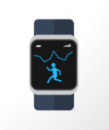


Collaboration agreement between mdt and fscit
Module User Requirement
Worker/User
(with wearable)
Web and Mobile Application for Admin
Able to provide a good enough positioning data in indoor environment
Able to provide more than one way for positioning at outdoor environment
Web Server
Database
Analyse Data
(Cell Tower Information and WiFi)

Slide 7
Project Objectives
To monitor heart conditions and track the locations of outdoor workers in real time.
To enable two-way communication between site supervisors and workers.
WeCare
MDT Innovations
Indoor Positioning
Backend System
Mobile Application
Admin Web Application
Ong Jia Aun
Ong Seow Sze
Wang Zhong Qi
Teoh Khau Kheng

Slide 8
Literature Review
Reference | Aim of Work | Result | Gap
Liu et al. (2007) Gu et al. (2009) Hossain et al. (2015) | An overview of existing work on indoor positioning. | A lot of different techniques has been used and implemented to varying level of accuracy. | Most techniques have a minimum requirement that the wearable device does not have.
Dedes & Dempster (2005) | A look on feasibility of GPS for indoor positioning and ways to improve it. | Proposed using cellular network to assist in refining indoor positioning (AGPS). | Is not sufficiently accurate and might not be able to get mobile signal.
Yang et al. (2010) | Propose ways of localizing position using cellular network (base station) information. | Propose improvements of accuracy using RSS thresholding, boundary filtering and tower-based regrouping. | Cell tower information is not publicly available.

Slide 9
REFERENCES
Dedes, G., & Dempster, A. G. (2005, September). Indoor GPS positioning-challenges and opportunities. In Vehicular Technology Conference, 2005. VTC-2005-Fall. 2005 IEEE 62nd (Vol. 1, pp. 412-415). IEEE.
Gu, Y., Lo, A., & Niemegeers, I. (2009). A survey of indoor positioning systems for wireless personal networks. IEEE Communications surveys & tutorials, 11(1), 13-32.
Hossain, A. M., & Soh, W. S. (2015). A survey of calibration-free indoor positioning systems. Computer Communications, 66, 1-13.
Liu, H., Darabi, H., Banerjee, P., & Liu, J. (2007). Survey of wireless indoor positioning techniques and systems. IEEE Transactions on Systems, Man, and Cybernetics, Part C (Applications and Reviews), 37(6), 1067-1080.
Yang, J., Varshavsky, A., Liu, H., Chen, Y., & Gruteser, M. (2010, September). Accuracy characterization of cell tower localization. In Proceedings of the 12th ACM international conference on Ubiquitous computing (pp. 223-226). ACM.

Slide 10
Problem Statements of the module
90% of the time, people tracking happens in indoor environment. Weighted average is a popular technique used for indoor positioning (tracking). However, it is less accurate unless boundary filtering is adopted.
Most techniques requires information such as angles, time of flight (TOF), Bluetooth or RFID to perform accurate triangulation. However, the wearable device provided have limited info (GPS, base station/cell tower and WiFi).
For outdoor positioning, GPS is still state of the art. In the case where GPS is unavailable, the fall back is to obtain cell tower database to do cell tower positioning.

Slide 11
Module Objectives
To develop a framework for indoor positioning using boundary-filtered weighted average technique
To switch between indoor and outdoor positioning automatically based on data received from wearable device
To test the performance of indoor positioning framework in real-time

Slide 12
System FLOW
Data packet
Cell Tower Details
WiFi SSID + RSSI
Heartrate
Processed Data
Data
User Device
Server Backend
Server Database
Web / Mobile Application
Raw Data
Processed Data
Triangulation Algorithm

Slide 13
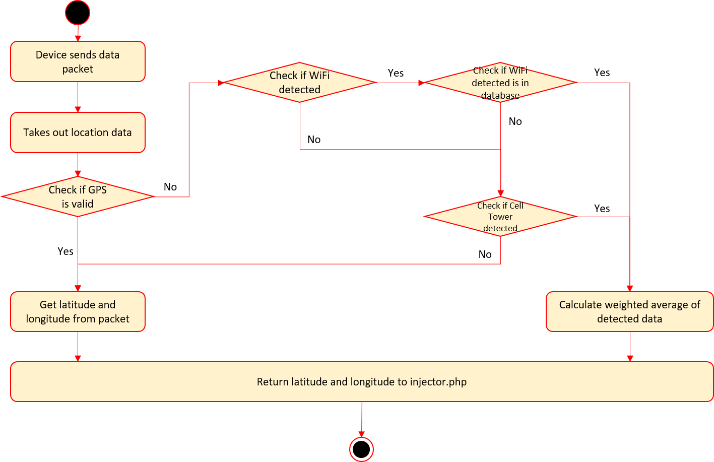
Module flow

Slide 14
Raw data packet
[3G*15052018*00E6*UD2,170118,030135,V,22.570675,N,113.8621067,E,0.00,0.0,0.0,0,82,22,0,0,00000010,1,255,502,16,21091,25021,137,3,mdtresearch@unifibiz,6c:72:20:3d:28:54,-64,GWNET,1c:1d:86:41:11:81,-90,Sunway Pinnacle_Guest,1c:1d:86:41:11:83,-93,12.7]
GPS
Cell tower
WiFi

Slide 15
Work done : implementing the Weighted average calculation
Using GSM data
Using WiFi RSSI

Slide 16
Pseudocode of calculation on database query
Database info
M1 = X1, Y1
M2 = X2,Y2
M3 = X3,Y3
Let input data be [ [ M1, RSSI1 ], [ M2, RSSI2 ], [ M3, RSSI3 ] ]
We calculate the weighted signal for each input data
W1 = RSSI1/ (RSSI1 + RSSI2 + RSSI3)
W2 = RSSI2/ (RSSI1 + RSSI2 + RSSI3)
W3 = RSSI3/ (RSSI1 + RSSI2 + RSSI3)
X = W1*X1 + W2*X2 + W3*X3
Y = W1*Y1 + W2*Y2 + W3*Y3

Slide 17
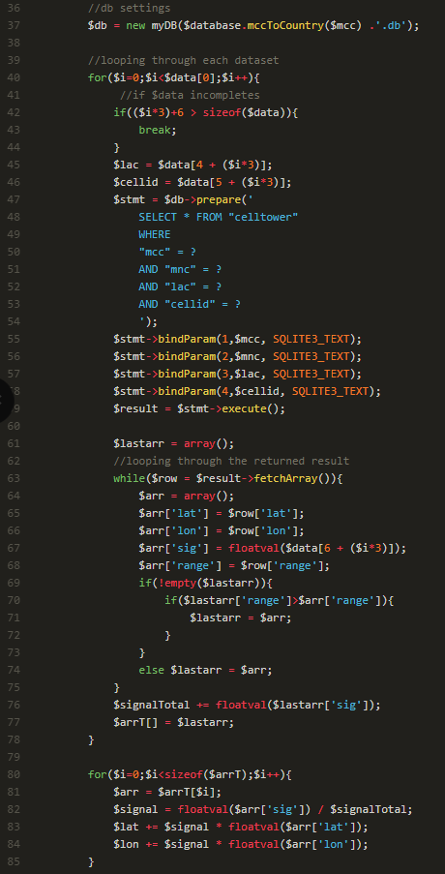
Translation to php codes

Slide 18
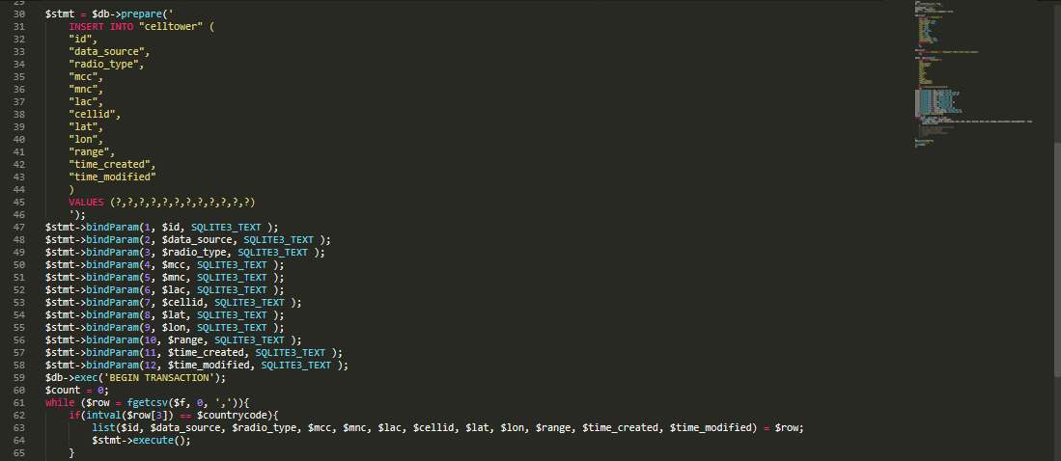
WORK DONE: Generate Database from online sources
Extract data from .csv file and generate SQLite database for faster querying.

Slide 19
Code demo

Slide 20

Project Achievement
Wearable device is SIM card based, thus this project has the potential to track any SIM card based devices such as mobile phones.
MDT current engagements include Celcom Malaysia and China Telecom
This project has won 2nd runner up in MDEC’s PITCH competition on 21 November 2018

Slide 21
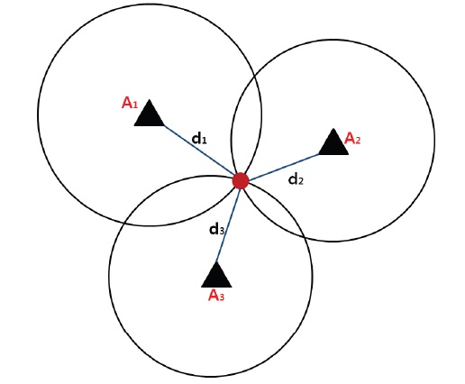
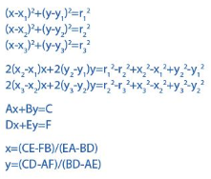
Future work : implementing the Trilateration calculation

Slide 22
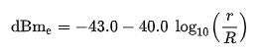
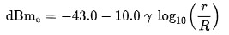
Issues with trilateration implementation
Signal strength is send by device instead of distance
Equation 1: Less accurate than Weighted average
Equation 2: Path loss exponent not available due to unpredictable factors (eg. environment, device)
Reference:
Miranda, Jorge & Abrishambaf, Reza & Gomes, T & Cabral, Jorge & Tavares, Adriano & Monteiro, João. (2013). Path Loss Exponent Analysis in Wireless Sensor Networks: Experimental Evaluation. 10.1109/INDIN.2013.6622857.

Slide 23
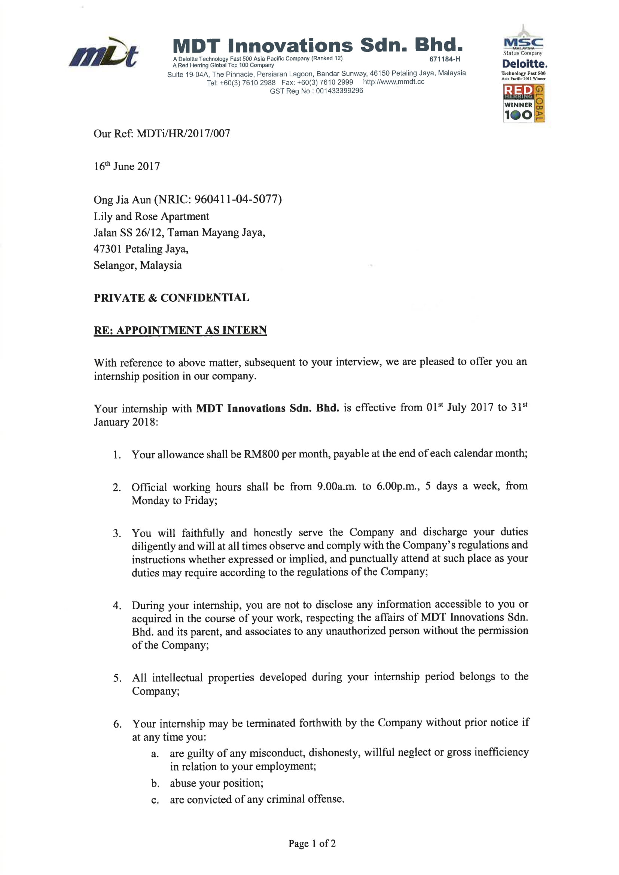
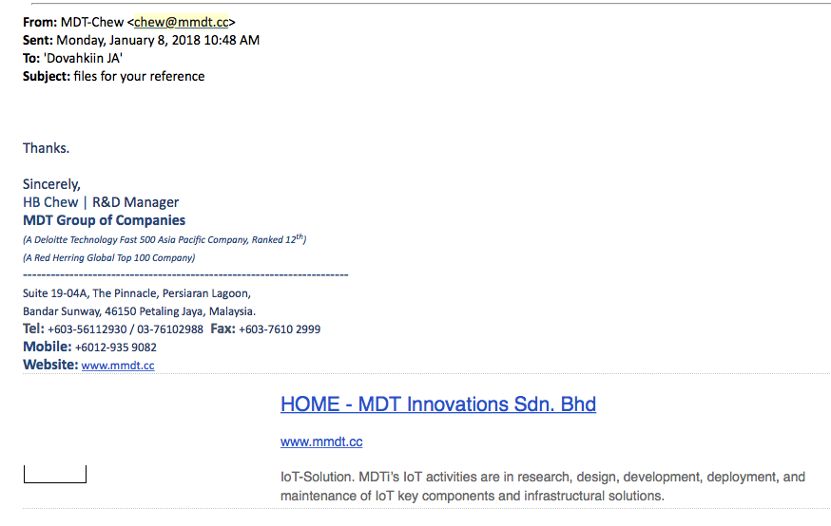
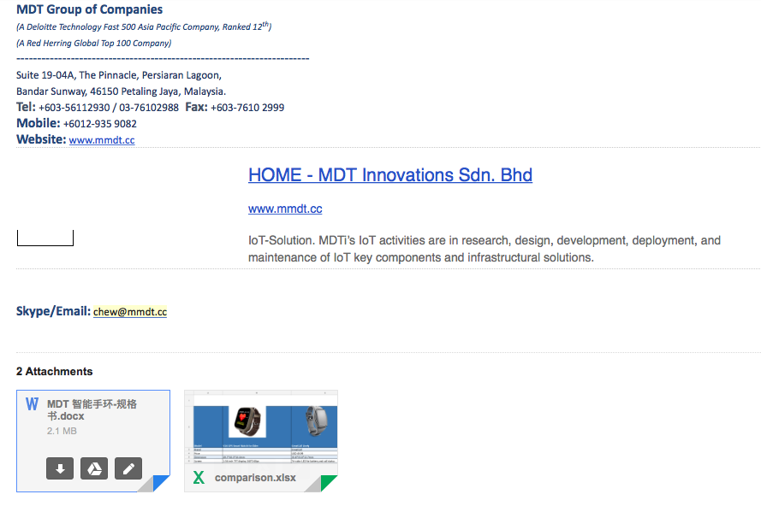
Stakeholder initiatives

Slide 24
Q & A

